Slide 1
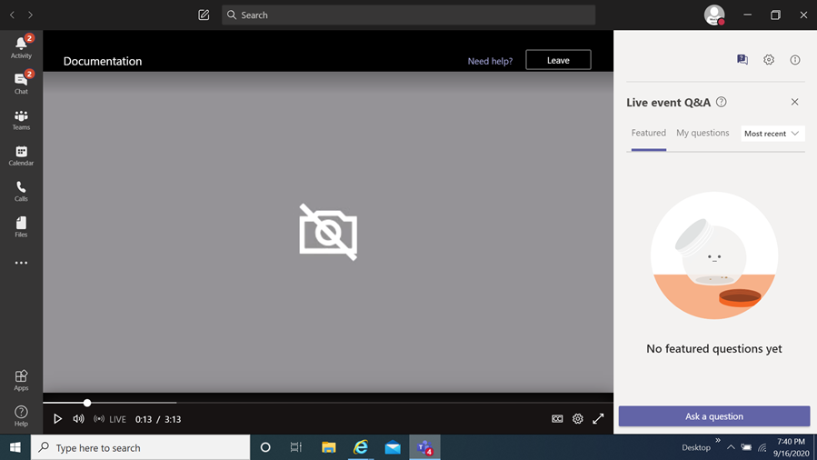
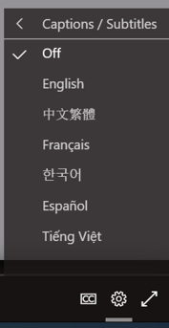
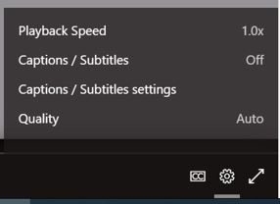
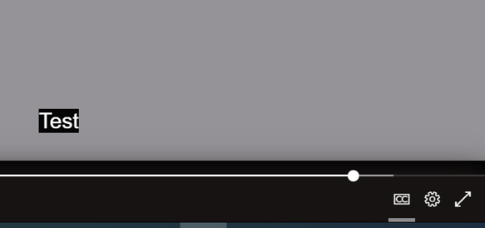
FY23 Underserved Communities Projects (UCP)
Award Information Session
How you can view the multi-lingual closed captions
Select this item
When you select it a menu appears,
choose captions / subtitles
It will then display the language chosen
You then select
the language of choice
Disclaimer
The translations provided in this application use what is referred to as mechanical translation technology. Although this method of translation is very effective and provides a high rate of accuracy it is NOT 100% word for word accurate. Things that may affect it are the quality of the microphone used and potentially a person speaking that may have an accent.

Slide 2
FY23 Underserved Communities Projects (UCP)
Award Information Session
March 7, 2024
Prepared by Montgomery County Office of Grants Management

Slide 3
Congratulations!
This meeting will be recorded and posted for future viewing on the Office of Grants Management online application portal
The slide deck will also be posted in the same location for your reference
Online Application Platform Home Page: https://mcmdgrants.smapply.org
Grant Program Page: https://mcmdgrants.smapply.org/prog/FY23UCP

Slide 4
Information Session Agenda
Why you won a grant through this program
Explaining Multi-Year awards
Next Steps and Action Items
Reviewing the approval process
Reviewing the grant agreement template
Walk through the Tasks on the application platform
Open up for participant questions (put your questions in the Q&A box)
Any questions we cannot answer during the Information Session will be addressed and posted on the platform.
Notes:
Next slide presented by OFSR

Slide 5
UCP Grant Program Priorities
Nonprofit organizations based in underserved communities within Montgomery County, have a mission focused on serving these communities, and have limited or no FY23 funding from the County;
Demonstrate a strong understanding of their target community’s needs and an effective program strategy to effectively meets these needs;
Provide services, advocacy, or other support to the target community that is not already funded by other County resources;
Provide technically, culturally, and/or linguistically proficient services to the target community; and
Demonstrate a broad base of impact through their proposal to their target community.
Notes:
The Office of FSR launched in February of 2023 with the hiring of our exec dir HB, and was created as a result of the COVID-19 Food sec task force. County Council established the office in July 2022 under bill 20-22 with the purpose of having a distinct agency w/i County Gvt that is tasked with developing/implementing …...

Slide 6
UCP Scoring Criteria
Soundness of the Proposal (20 points) – How strong is the proposed strategy?
Program Goals, Objectives and Services (20 points) – How well does the proposal achieve the grant programs’ goals?
Program Evaluation (10 points) – Is the proposal’s evaluation plan inline with the programs’ goals and realistic to implement?
Organizational Capability and Relevant Experience (20 points) – Does the organization demonstrate the ability to implement the submitted proposal and its stated goals?
Sound Fiscal Management and Budget (10 points) – Is the proposed budget realistic and can the organization manage it?
Community Outreach (20 points) – How well can the organization reach the proposal’s targeted community?
Notes:
The Office of FSR launched in February of 2023 with the hiring of our exec dir HB, and was created as a result of the COVID-19 Food sec task force. County Council established the office in July 2022 under bill 20-22 with the purpose of having a distinct agency w/i County Gvt that is tasked with developing/implementing …...

Slide 7
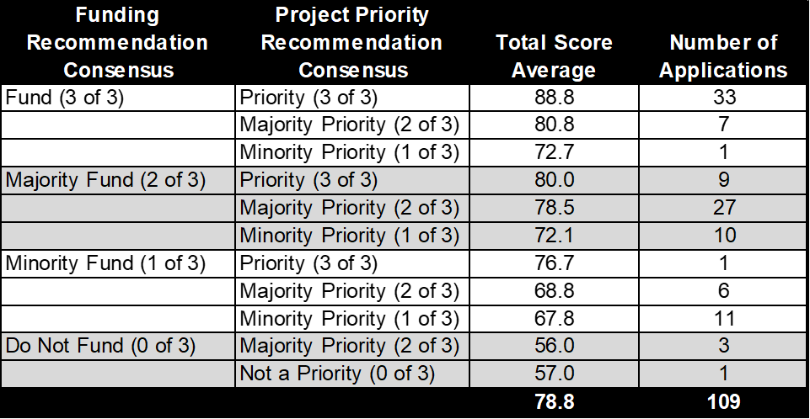
UCP Awarding Process
An MCG staff member independently evaluated and scored after receiving a reviewer training
Reviewers were bound to the scoring and evaluation criteria outlined in the UCP Program Details Document
OGM compiled review data and applied an algorithmic method, based on UCP priorities, to rank proposals
If anyone took the same data and applied the same methodology, they would come to the exact same award results
The key variables that shaped the final award recommendations were:
Overall Funding Recommendation
Project Priority Recommendation
Total Score Average
FY23 Non-Competitive Contracts
Based in Montgomery County
Reductions to lowest recipients to meet availability of funds
Notes:
The OFSR's programs and initiatives are rooted in equity and innovation, with a systems-focus and data-driven perspective

Slide 8
Multi-Year Awards
Funding has been competed and awarded with planned resources from FY24, FY25, and FY26.
A single grant agreement can only contain funding from a single fiscal year.
Each new fiscal year requires a new grant agreement but NOT necessarily a new competition.
Each fiscal year is planned to fund 12 months of the awarded project.
The 12 months does NOT have to align with the fiscal year calendar for the funded year.
Multi-Year funding is CONTINGENT on Council appropriations AND satisfactory project performance
If the County Council does not appropriate sufficient funding in a given fiscal year a project may have its funding reduced or eliminated for that fiscal year.
Also, the award size could increase if the County Council appropriates inflationary increases or other required increases.
If a project is not performing well, implementing its proposal as approved, or an organization fails to stay in compliance then funding may not be renewed and an existing grant agreement could be cancelled mid-fiscal year. Grant Monitors and other County stakeholders will make this assessment.

Slide 9
Multi-Year Award Renewal Process
IF funding is available AND project performance is satisfactory, the County and the Recipient will renew funding through a NEW grant agreement each fiscal year.
After Council passes its appropriation (roughly late May each year), the Grant Monitor will reach out to the Recipient notifying them of the County’s intent to renew (or not) funding.
The Recipient will provide an updated proposal for the coming fiscal year through SM Apply.
Contents of the updated proposal will largely be identical to the key components of the original application (i.e. Narrative, Budget, Budget Narrative, Timeline, Performance Plan, & Staffing Plan)
OGM and the Grant Monitor will review the new fiscal year proposal to ensure it is aligned with the scope of the original award.
Renewal of an award is also an opportunity pivot a project’s strategy to adapt to lessons learned and/or address new challenges. Changes still must be within the broad original proposal goals.
If approved, the proposal will be integrated into a new grant agreement for that fiscal year and provide a further 12 months of funding; this will not have to align with the fiscal year calendar.
If not, the Recipient will need to revise the updated proposal until approved by the County.

Slide 10
Next Steps for FY23 Awards
Respond by Friday, March 15, 2024 to accept or deny this grant award. For a rejection, an email is sufficient.
If accepting:
Log in to the Office of Grants Management Application Portal using the applicant account;
Select the FY24 Underserved Community Projects Grant Program; and
Complete the “Post-Award Modified Budget and Scope Updates” task that has been assigned to you.
Ensure your registration with the Montgomery County Central Vendor Registration System (CVRS) (https://mcipcc.net) is up to date.
Verify that your organization is in good standing with the Maryland State Department of Assessment and Taxation (SDAT). (https://egov.maryland.gov/businessexpress/entitysearch).
Review the Resources for Awardees page on our website.
Notes:
The Office of FSR launched in February of 2023 with the hiring of our exec dir HB, and was created as a result of the COVID-19 Food sec task force. County Council established the office in July 2022 under bill 20-22 with the purpose of having a distinct agency w/i County Gvt that is tasked with developing/implementing …...

Slide 11
Updating FY23 Awards
Due to the large delay in awarding funds, award winners must submit updated materials to provide a realistic Scope for their grant agreements.
All updated documents must be shared within the SM Apply Office of Grants Management Application Portal.
Please update the following:
Updated Project Budget to match required changes and/or the actual awarded amount.
Updated Project Timeline to match required changes and a new 12 month period. Start date can be anytime before June 30, 2024.
Optional updates to other proposal sections as needed.
All updated materials must remain within the overall scope of the original proposal.
Notes:
The Office of FSR launched in February of 2023 with the hiring of our exec dir HB, and was created as a result of the COVID-19 Food sec task force. County Council established the office in July 2022 under bill 20-22 with the purpose of having a distinct agency w/i County Gvt that is tasked with developing/implementing …...

Slide 12
Award Approval Process
Recipient submits proposal updates through SM Apply.
OGM will review to ensure updates are in line with the awarded project scope.
OGM will combine the proposal with other parts of the grant agreement into a single PDF Grant Agreement Package.
OGM will email the Recipient the Grant Agreement Package for review and signature.
The Recipient will sign the Grant Agreement Package and upload it into SM Apply.
OGM will then transfer the Grant Agreement Package to the Office of County Attorney (OCA) for review and signature.
OGM will then transfer the OCA signed Grant Agreement Package to the Chief Administrative Officer, or his designee, for review and signature.
The fully signed Grant Agreement Package will be emailed back to the Recipient.
OGM will processes a Direct Purchase Orders (DPO) for the Grant Agreement through the Department of Finance.
OGM will email a copy of the approved DPO to the Recipient.
If any stakeholder finds an issue that requires changes then it is back to Step #1.
DO NOT begin implementation or any spending towards this project until a Grant Agreement is signed by all parties AND you have a DPO in hand.
Notes:
The Office of FSR launched in February of 2023 with the hiring of our exec dir HB, and was created as a result of the COVID-19 Food sec task force. County Council established the office in July 2022 under bill 20-22 with the purpose of having a distinct agency w/i County Gvt that is tasked with developing/implementing …...

Slide 13
UCP Grant Agreement Package
Grant Agreement. This is the primary legal document that supersedes all others. Includes data from the proposal.
General Conditions of Grant Agreement Between County and Grantee. More general conditions but also legally binding.
Proposal Components (or updated versions of these)
Project Strategy/Narrative
Project Budget
Project Budget Narrative
Project Work Plan/Timeline
Project Performance Plan
Any proposed changes to the standard language of the Grant Agreement and/or General Conditions require vetting and approval by the Office of the County Attorney, Office of Grants Management, and potentially other County government stakeholders.
Notes:
The Office of FSR launched in February of 2023 with the hiring of our exec dir HB, and was created as a result of the COVID-19 Food sec task force. County Council established the office in July 2022 under bill 20-22 with the purpose of having a distinct agency w/i County Gvt that is tasked with developing/implementing …...

Slide 14
UCP Grant Reporting
The Grant Agreement will provide an upfront payment at the start of the Grant Term. For this payment, only the following is required.
An invoice (or Request for Grant Payment if your organization does not issue invoices) that meets County invoice standards.
The Grant Agreement requires that for the remaining payments, Programmatic and Financial Reporting is required. To receive a payment, Recipients must submit via the SM Apply application platform:
Programmatic Reporting that meets the Grant Agreement requirements; including in the format of the provided templates;
Financial Reporting that meets the Grant Agreement requirements; including in the format of the provided templates; and
An invoice (or Request for Grant Payment if your organization does not issue invoices) that meets County invoice standards.
OGM will provide required Programmatic and Financial Reporting Templates.
The Grant Agreement allows the Grant Monitor to audit award finances at will.
Notes:
The Office of FSR launched in February of 2023 with the hiring of our exec dir HB, and was created as a result of the COVID-19 Food sec task force. County Council established the office in July 2022 under bill 20-22 with the purpose of having a distinct agency w/i County Gvt that is tasked with developing/implementing …...

Slide 15
Example Payment &
Reporting Structure
Reporting and Payment Schedule | CY Date Range | Reporting Due Date | Percentage of Total Award | Amount to be Disbursed
Confirmation of Training Attendance | N/A | N/A | 25% | $18,750
Performance Period 1 | May 1, 2024 – July 31, 2024 | August 30, 2024 | 25% | $18,750
Performance Period 2 | August 1, 2024 – October 30, 2024 | November 30, 2024 | 25% | $18,750
Performance Period 3 | November 1, 2024 – January 30, 2025 | February 28, 2025 | 20% | $15,000
Final Report | May 1, 2024 – April 30, 2025 | June 30, 2025 | 5% | $3,750
Total to be Disbursed |  |  | 100% | $75,000
Notes:
The Office of FSR launched in February of 2023 with the hiring of our exec dir HB, and was created as a result of the COVID-19 Food sec task force. County Council established the office in July 2022 under bill 20-22 with the purpose of having a distinct agency w/i County Gvt that is tasked with developing/implementing …...

Slide 16
Before Seeking Payment…
Make sure your payment request package is complete AND checked for accuracy of details.
Ensure your registration with the Montgomery County Central Vendor Registration System (CVRS) (https://mcipcc.net) is up to date.
Ensure that your organization is in Good Standing with the Maryland State Department of Assessment and Taxation (SDAT). (https://egov.maryland.gov/businessexpress/entitysearch).
Notes:
The Office of FSR launched in February of 2023 with the hiring of our exec dir HB, and was created as a result of the COVID-19 Food sec task force. County Council established the office in July 2022 under bill 20-22 with the purpose of having a distinct agency w/i County Gvt that is tasked with developing/implementing …...

Slide 17
Next on the Agenda
Overview of the Grant Agreement and the General Conditions of Grant Agreement Between County and Grantee.
Demonstration of How to Provide Updated Proposal Documents through SM Apply
Notes:
The Office of FSR launched in February of 2023 with the hiring of our exec dir HB, and was created as a result of the COVID-19 Food sec task force. County Council established the office in July 2022 under bill 20-22 with the purpose of having a distinct agency w/i County Gvt that is tasked with developing/implementing …...

Slide 18
Further Questions?
Ali Hoy
Outgoing Grants Program Manager
Office of Grants Management
240-773-3384
grants@montgomerycountymd.gov
OGM Website
https://montgomerycountymd.gov/ogm/
OGM online grants application platform https://mcmdgrants.smapply.org

